Slide 1

Experiential Learning Project Assessment-I on “Personal Expense Tracker” under the course Python Programming Language (N-PCCCM304P)
Presented By: Shreyash Amle
[CM25052]
Under the Guidance
of
Mrs. Mayuri Getme
Session:2026-27 (ODD )
Department of CSE(AI&ML)
S. B. JAIN INSTITUTE OF TECHNOLOGY MANAGEMENT AND RESEARCH,NAGPUR
An Autonomous Institute, Affiliated to RTMNU, Nagpur
S. B. Jain Institute of Technology Management and Research

Slide 2
Contents
Problem statement
Objectives
Algorithm
Flowchart/pseudocode
Understanding of Python logic
GitHub account, repository creation, uploading code, meaningful commits, collaboration, individual contribution

Slide 3
1. Problem Statement
Personal Expense Tracker :
Develop a Python-based application that allows users to track their daily expenses, categorize them, and generate monthly reports in a visual format using libraries like Matplotlib or Seaborn.
2. Objective
To develop a personal expense tracking application using Python.
To record expenses with amount, category, and date.
To categorize expenses into groups such as Food, Travel, Shopping, Bills, and Others.
To display all recorded expenses in a formatted manner
To understand the basics of Python programming such as lists, loops, functions, and conditional statements.
.

Slide 4
3. Algorithm
Start the program.
Create an empty list named expenses.
Display the main menu.
If the user selects Add Expense:
Enter Date.
Enter Amount.
Enter Category.
Enter Description.
Store the expense in the list.
If the user selects View Expenses:
Check if the list is empty.
If empty, display "No Expenses Found".
Otherwise, display all expenses.
If the user selects Exit, terminate the program.
Stop.

Slide 5
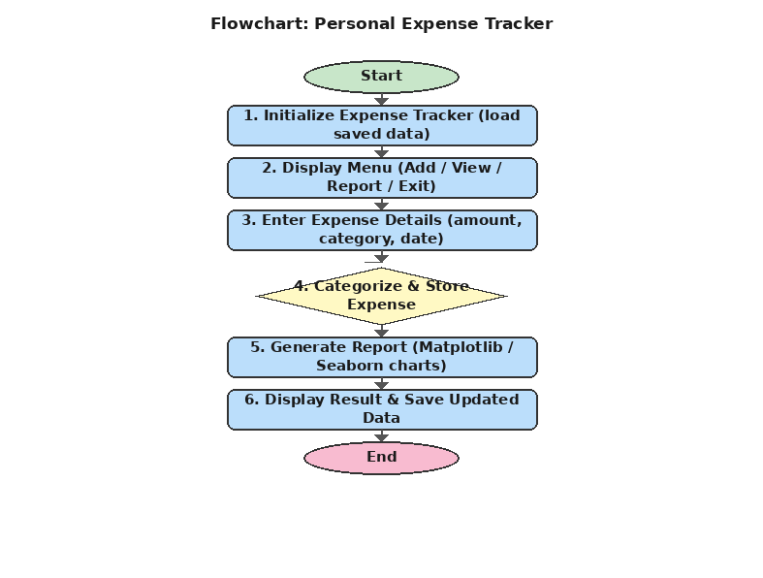
4. Flowchart

Slide 6
5. Understanding of python logic
The project is based on fundamental Python concepts:
List: Stores all expense records.
Dictionary: Stores details of each expense (Date, Amount, Category, Description).
Functions: Separate tasks such as adding and viewing expenses.
While Loop: Keeps the menu running until the user exits.
If-Else Statements: Executes different operations based on the user's choice.
Try-Except: Handles invalid input (such as entering text instead of numbers).
append(): Adds a new expense to the list.
for Loop: Displays all stored expenses one by one.

Slide 7
7. GitHub Account, Repository & Collaboration
GitHub Account
Create a GitHub account.
Example Username: your_username
Repository Name Creation
Create a new repository - Personal-Expense-Tracker
Uploading Code
Upload the Python project file (EXP-Phase-1.py).
Add a README.md file explaining the project.
Push all changes to GitHub.

Slide 8
Thank You

